Slide 1








ADVERTISING SALES DATASET
DATASET
PREPARED BY
ALANOUD AWAJI
RAFAA ABUAZZAH
MARCH 2024

Slide 2
TABLE OF CONTENT
1
DATASET OVERVIEW
4
DATASET insights
and visualization
2
DATASET EXPLATATORY DATA ANALYSIS
5
DATASET insights
and visualization
3
DATASET BENEFECIRIES
6
CONCLUSION

Slide 3
DATASET OVERVIEW
Advertising can be an unpredictable world, to get your audience’s attention in the right time and place is a bit of a challenge.
but can we make this world more predictable? the answer is yes!

Slide 4
DATASET OVERVIEW
The dataset describes the sales revenue generated taking into consideration the advertisement costs of multiple channels.
The purpose of the data is to analyze
the relationship between advertising expenditures and sales outcome.

Slide 5

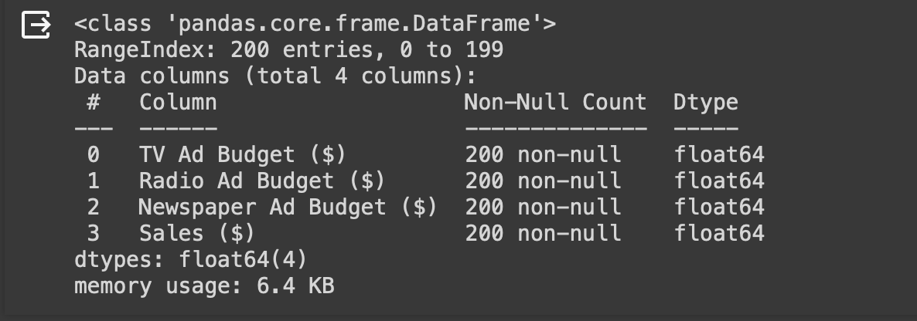
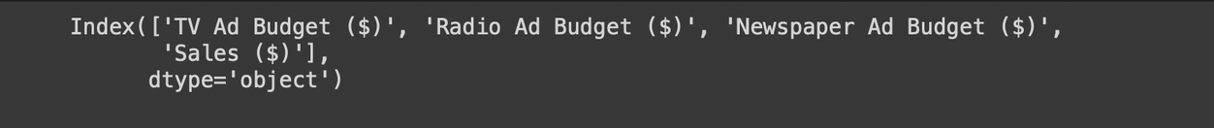
DATASET EDA
INFO() FUNCTION
The dataset contains:
4 Columns and 200 Rows.
There are no missing columns, no duplicates
in the data.
COLUMN DATAFRAME ATTRIBUTE
Notes:
Using df.info() and df.column, we extracted information about the data, such as the Number of Rows and Columns, Names of Columns, Data types, and
Missing Values.

Slide 6
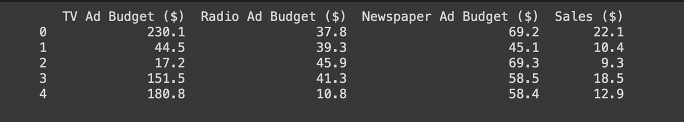
DATASET EDA
HEAD() FUNCTION
Using df.head(), we extracted the first five columns

Slide 7



DATASET BENEFECRIES
Who can benefit from the data?
ADVERTISERS
AND MARKETEERS
BUSINESS OWNERS AND MANAGERS
DATA SCIENTISTS AND ANALYSTS
Notes:
- Marketeers: Gain insights into how channels impact the sales, for them to optimize advertising strategies and allocate budgets effectively.
Business owners and managers:
Evaluate the impact of advertising on sales, to make informed decisions about budget allocation, marketing campaigns, and sales forecasting.
Data scientists and analysis: Develop predictive models and conduct advanced analytics to predict sales based on certain variables.

Slide 8
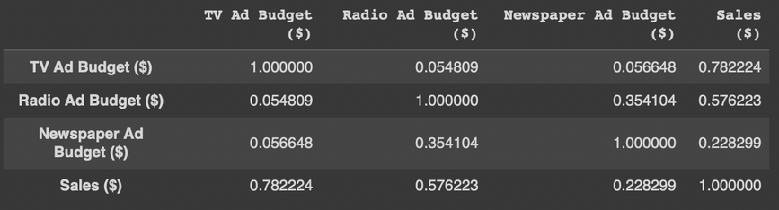
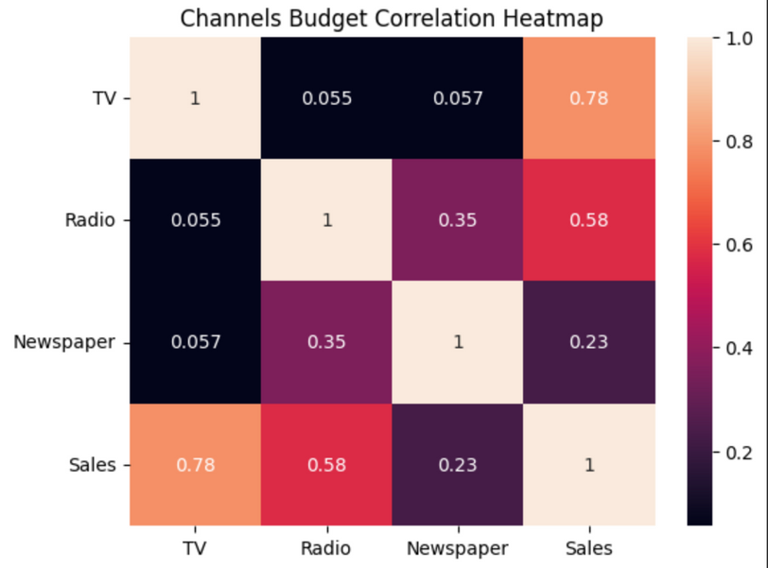

DATASET
INSIGHTS AND VISUALIZATION
Correlation Matrix and Heatmap
Multiple questions can arise after reviewing the dataset.
Out of the three channels we have,
what affects the
sales the most?
5K
5K
5K

Slide 9
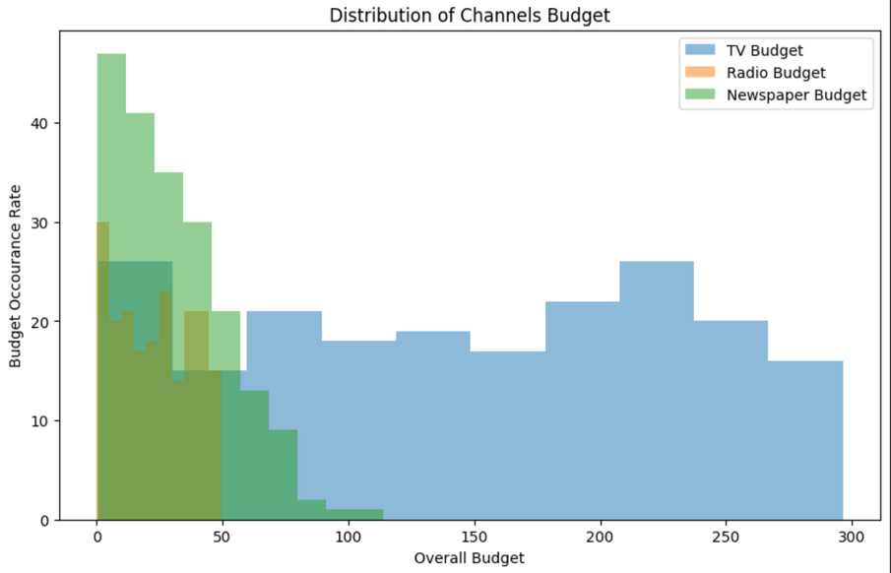
DATASET
INSIGHTS AND VISUALIZATION
Histogram
Multiple questions can arise after reviewing the dataset.
What is the budget distribution across different channels?
5K
5K
5K

Slide 10
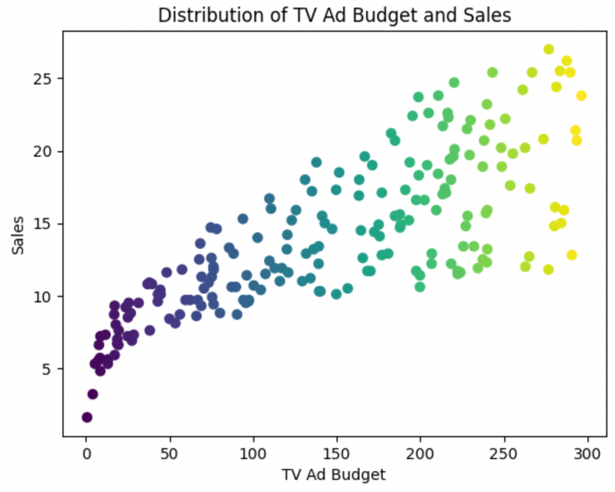
DATASET
INSIGHTS AND VISUALIZATION
Scatterplot
Multiple questions can arise after reviewing the dataset.
Is there a relationship between the
tv budget and sales?
5K
5K
5K

Slide 11
CONCLUSION
we can use linear regression model to predict the best channels to allocate budget to increase sales.
What model can we apply on the dataset? and why?
5K
5K
5K
5K
5K
5K

Slide 12

ADVERTISING SALES DATASET
Dataset Reference: KAGGLE

Slide 13

Thank you!

